Slide 1
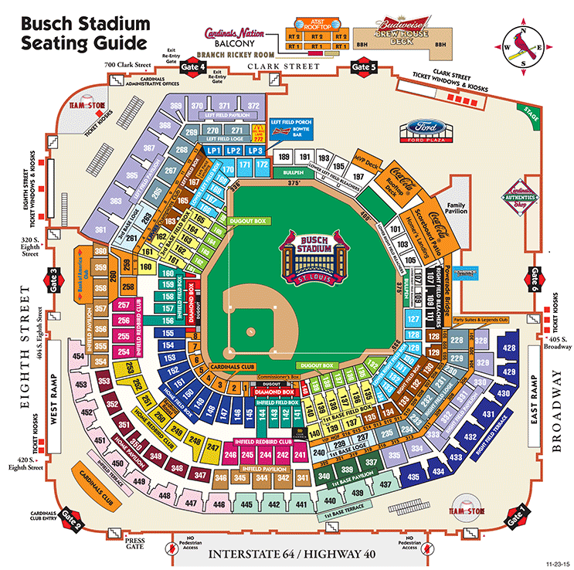
Support the Boy Scouts
Sunday
July 14, 2024
$50 per ticket normal price $90
-cash or checks
-make checks out to Troop 216

